Slide 1
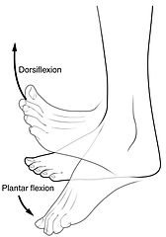
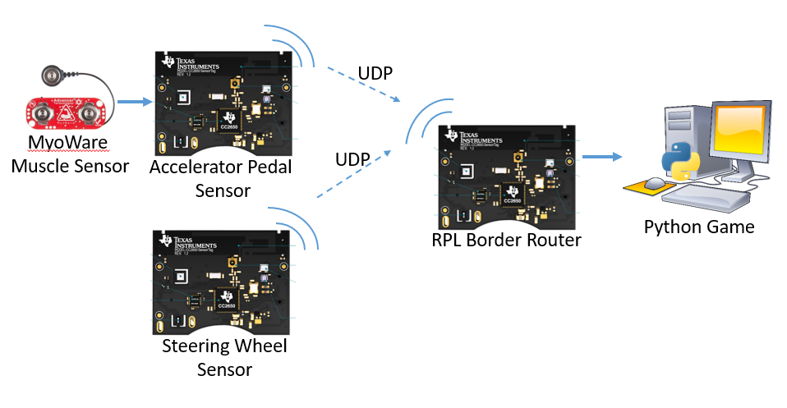
Gamification of Rehabilitation Using Muscle Sensors
Michael Redpath, Michael Garthe, Callum Sinclair, Athon Milane – Group L
PROJECT AIMS
Develop an interactive platform for rehabilitation
Games have been shown to improve both physical and cognitive ability, this is especially true for rehabilitation as gamification can turn repetitive exercises into an engaging experience
Interface with muscle sensors
Muscle sensors are used to capture the muscle activation of individual muscles as rehabilitative exercises are performed
Figure 1: Dorsiflexion and plantarflexion exercises (Cheprasov, 2018)
A computer game will guide patients through their exercises and use their muscle activation and movement data to provide them feedback on their exercises in a fun and interactive manner
Embedded System Capabilities
Capture the movement and muscle activation from several places on the patient as they perform exercises
Process the data to provide feedback to the patient in an interactive game environment
SYSTEM OVERVIEW
MyoWare Muscle Sensors
The muscle sensors detect muscle activation. They measure electromyography signals emitted by your muscles!
The electromyographic signals are cleaned by the MyoWare board and made available through an analogue interface
Muscles sensors will be placed on the legs to measure the muscle activation associated with ankle movement
TI SensorTags
Onboard Accelerometer and gyroscope measure movement
ADC reads MyoWare output
Data is sent via radio to base station
Wireless Communication
UDP Packets
Non Storing RPL Network
Contiki nullMac and nullRDC protocols
Data Processing
A Kalman filter was used to fuse the accelerometer and gyroscope values. This was to get the angle. A logistic regressor has been used on the muscle sensor data.
Python Games
Initially Python will be used control a car racing game.
RESULTS
System Performance
The user is able to reliably interface with the python games using the embedded device.
SensorTag Performance
During normal operation, the muscle sensor’s output is between 0V and 3V.
From user testing only 8-bit resolution was required to get reliable results.
The SensorTag’s 12-bit ADC provides far better accuracy than we need. This further improved the reliability.
Network Performance
Work had to be done to improve the packet-rate of the system to achieve a desirable rate.
Currently sending packets at 15Hz. This is fast enough to play most games.
Game Performance
The device was tested with a car game that involved forwards, brake, left and right controls.
User testing showed that, on average, players that used the device were able to complete the game within 10% of the score of players who used a keyboard.
CONCLUSIONS
Whilst the Sensortag struggles with high data rate wireless applications, it has shown to be reliable enough to control simple games.
The SensorTag was found to be suitable for interfacing with the MyoWare Muscle Sensor.
The
is not an effective wireless platform for high data rate games. This project has shown that it can be used for simple wireless games with for this application (high rate data, low-power not a major concern)
Better platform would be an nrf24l01-enabled dev board
(nrf24l01/2.4GHz used in commercial wireless controllers like mice and gamepads)
Further Work
This project could be expanded further to incorporate more games.
Additionally, the muscle sensors in this project were only used to measure foot exercises. This idea could be expanded to other muscle groups.
Figure 1: System Overview

